Slide 1
What Does Common Sense, and the Data Tell Us?
Food for Thought
Torney Smith
Spokane Regional Health District

Slide 2
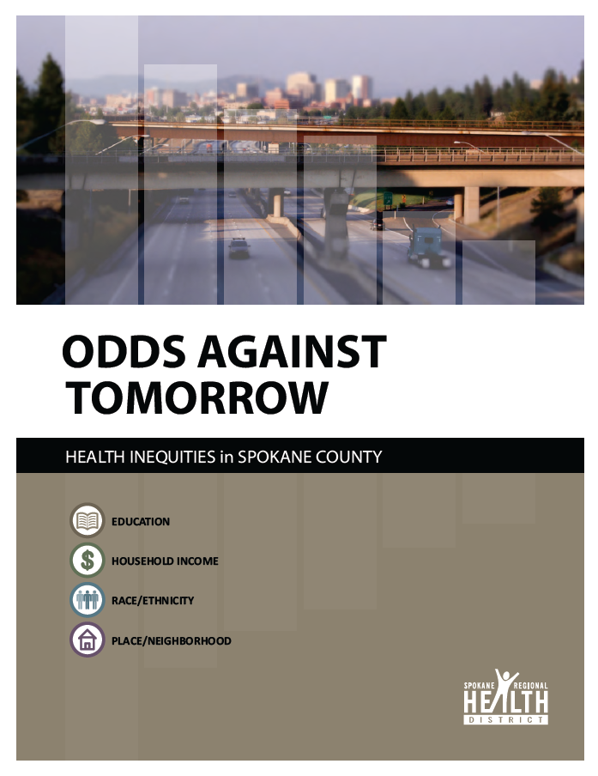
Odds Against Tomorrow

Slide 3
GPA by Homelessness, OSPI Data

Slide 4
Education samples
As an adult’s level of education increases, the likelihood of living in poverty significantly decreases.
As the parent’s level of education increases, the likelihood of their children living in poverty significantly decreases.
Adults with less education are less likely to have health insurance.
Adults with less education are more likely to smoke.
Adults with less education are more likely to engage in binge drinking.
Adults with less education are more likely to have had several adverse childhood experiences.
Adults with less education are more likely to have their activity limited by chronic illness
The less education mothers have, the more likely their babies will die before their first birthday

Slide 5
Economic Samples
The poorest individuals in Spokane County were the only ones earning less after eight years.
Children living with a single female parent are more likely to live in poverty.
The lower an adult’s income, the more likely they are to be physically inactive.
The lower an adult’s income, the more likely they are to experience poor mental health.
The lower an adult’s income, the more likely they are to cut or skip meals because there was not enough money to buy food.
The lower an adult’s income, the more likely they are to have diabetes.
The lower an adult’s income, the more likely they are to be obese.

Slide 6
Race and Ethnic Samples
Higher proportions of American Indian/Alaska Native, black, and Hispanic children live in poverty.
Mortality rate is highest among American Indians/Alaska Natives.
Non-Hispanic whites are living longer than any other racial/ethnic group.
Food insecurity is experienced more frequently among American Indians/Alaska Natives, blacks and Hispanics.
New HIV infection occurs more frequently among American Indians/Alaska Natives, blacks and Hispanics.

Slide 7
Place Samples
Life expectancy is approximately five years greater among females compared to males in Spokane County and Washington state, and females have a greater life expectancy in all neighborhoods in Spokane County.
The gap in life expectancy among females in Spokane County is approximately 19 years between the neighborhood with the highest life expectancy, Browne's Addition (86.49), and the neighborhood with the lowest life expectancy, Riverside (67.79).
Browne's Addition has the largest gap in life expectancy between genders; approximately 14 years.

Slide 8
