Slide 1
Integrating Behavioral Health and Medical Health Care

Slide 2
Overview of FBH
Frontier Behavioral Health (FBH) is a nonprofit organization that has been serving the Spokane region for more than 100 years. FBH has approximately 500 staff at more than a dozen locations throughout Spokane County and serves about 12,000 clients per year.

Slide 3
Overview of FBH
As the Lead Service Provider in the Spokane County Regional Support Network (SCRSN) system of care, FBH works closely with other service providers to ensure individuals have timely access to Psychiatric, Psychological and Specialist Consultation services.

Slide 4
Overview of FBH
FBH also collaborates with over 100 other mental health and substance use disorder treatment providers as well as social service, schools, law enforcement and health-care organizations throughout the region. This collaboration ensures that behavioral health services are not duplicated and the most efficient treatment is provided.

Slide 5
Services and Programs

Slide 6
Psychiatric Services – Medication Management
Medication management services include routine outpatient psychiatric diagnostic evaluations, medication management, and case consultation for both adults and youth who are enrolled in outpatient services within the SCRSN network. These services are provided by Psychiatrists, Psychiatric Advanced Registered Nurse Practitioners, Registered Nurses, Licensed Practical Nurses and Medical Assistants. Medication management services also include a Prescriber Walk-in Clinic to assist in meeting urgent needs of individuals who are enrolled in medication management services with FBH.

Slide 7
Psychiatric Services – Extended Community Services
Expanded Community Services (ECS) is designed to help overcome barriers to discharge for long-term hospitalized patients, primarily but not exclusively elderly individuals with chronic mental illness and behavioral problems.
These services, which are long-term in nature, include:
Comprehensive diagnostic assessment
Psychopharmacology consultation
Education and training in behavior management for skilled nursing and residential care facility staff
Behavioral interventions
Collaborative crisis management
Coordination of services with other community care providers
ECS is provided through arrangements with area nursing homes, assisted living facilities and adult family homes.

Slide 8
Psychiatric Services – Psychiatric Residential Consultation
The Psychiatric Residential Consultation program is designed to provide community-based mental health services for individuals in skilled nursing facilities who have complex mental health, medical and behavior management issues. Services provided include:
Comprehensive psychiatric diagnostic and nursing assessments
Clinical consultation regarding psychopharmacology and medication management
Education and training in symptom and behavior management for skilled nursing facility residents and staff
Psychiatric Residential Consultation is provided through arrangements with area nursing homes.

Slide 9
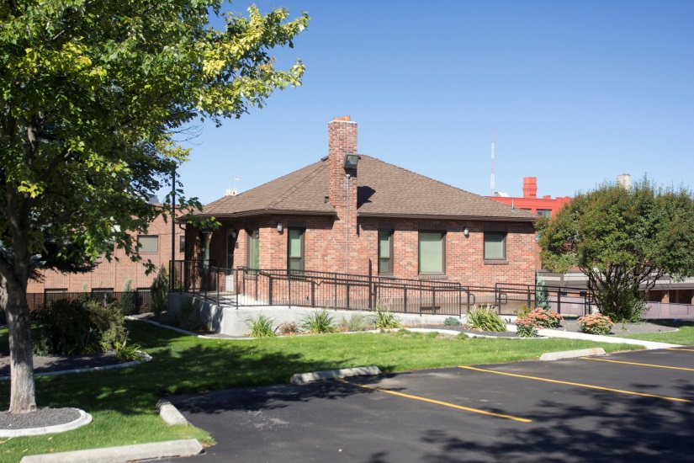
Partners for Health (Brick House)
Partners for Health provides comprehensive medical care for individuals enrolled in mental health services at Frontier Behavioral Health.
It is a partnership between Frontier Behavioral Health and Yakima Valley Farm Workers Association/Unify Community Health

Slide 10
Partners for Health (Brick House)
Eligiblility for services
To qualify for comprehensive medical care through the Partners for Health program, an individual:
Must be enrolled in services at Frontier Behavioral Health
Must be without an established Primary Care Provider
Have Medicaid coverage
Not seeking treatment for chronic pain issues

Slide 11
Partners for Health (Brick House)
Key Features:
The Frontier Behavioral Health primary clinician assists the individual in completing the application packet and submits it to Unify Community Health.
The individual and the clinician call Unify to schedule an appointment at the Brick House on the main FBH campus, 15 E. Pacific Avenue.
The clinician or a member of the treatment team attends appointments with the individual to provide support, coordination and consistent communication.

