Slide 1
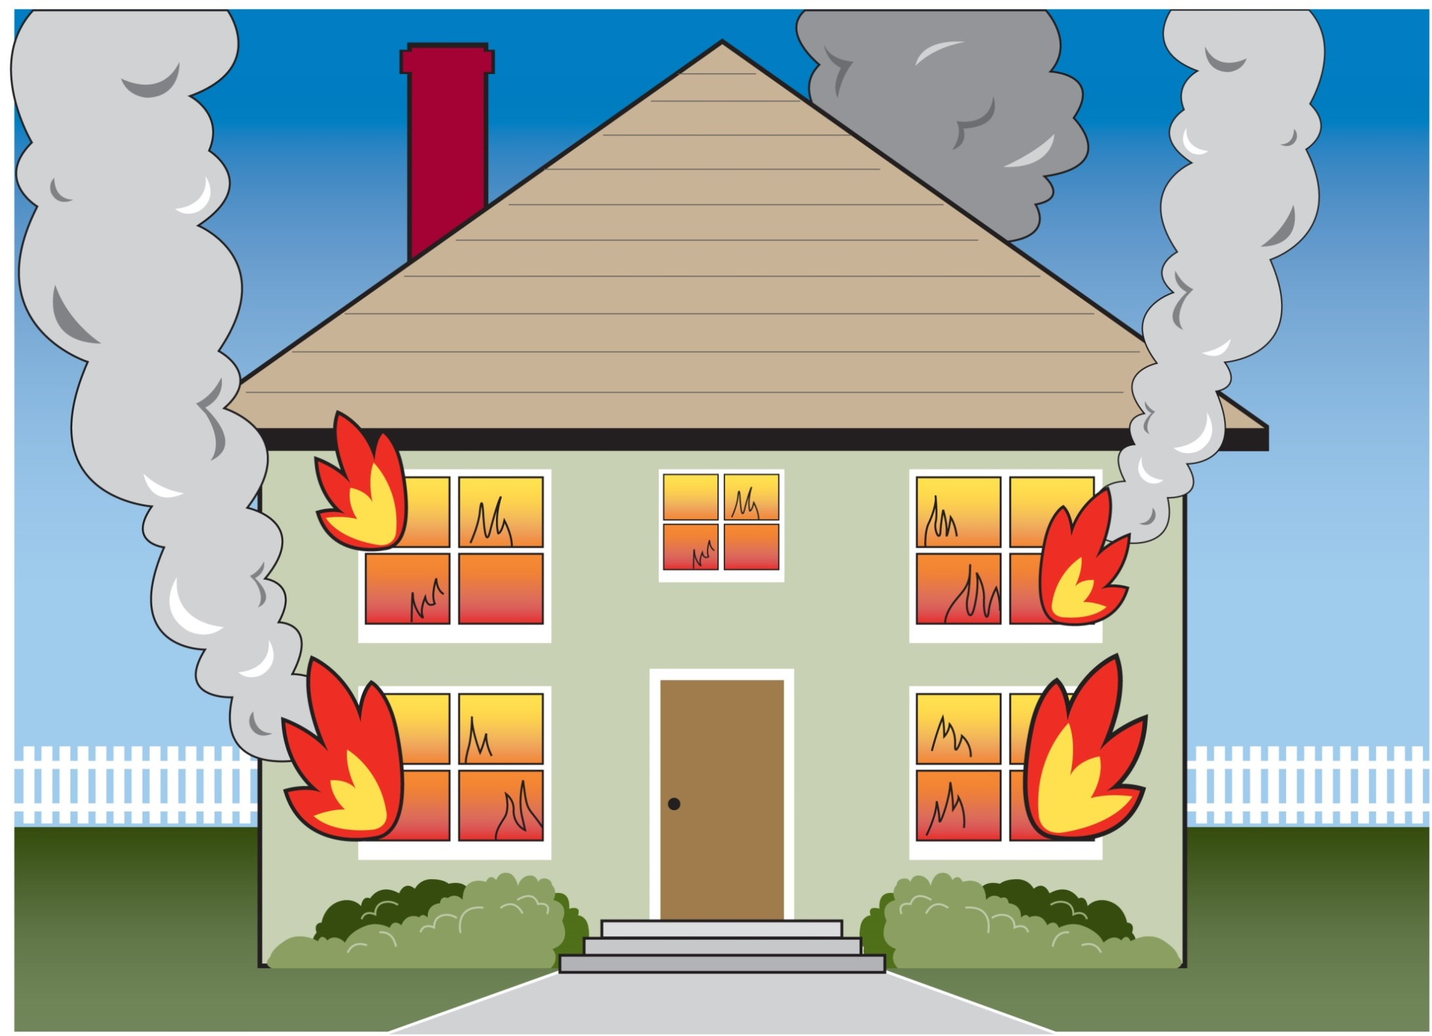
Notes:
FOUR FIRES RAGING:
State Psychiatric Hospitals
Children’s Intensive Mental Health Services
Psychiatric Boarding
Forensic Competency Services

Slide 2
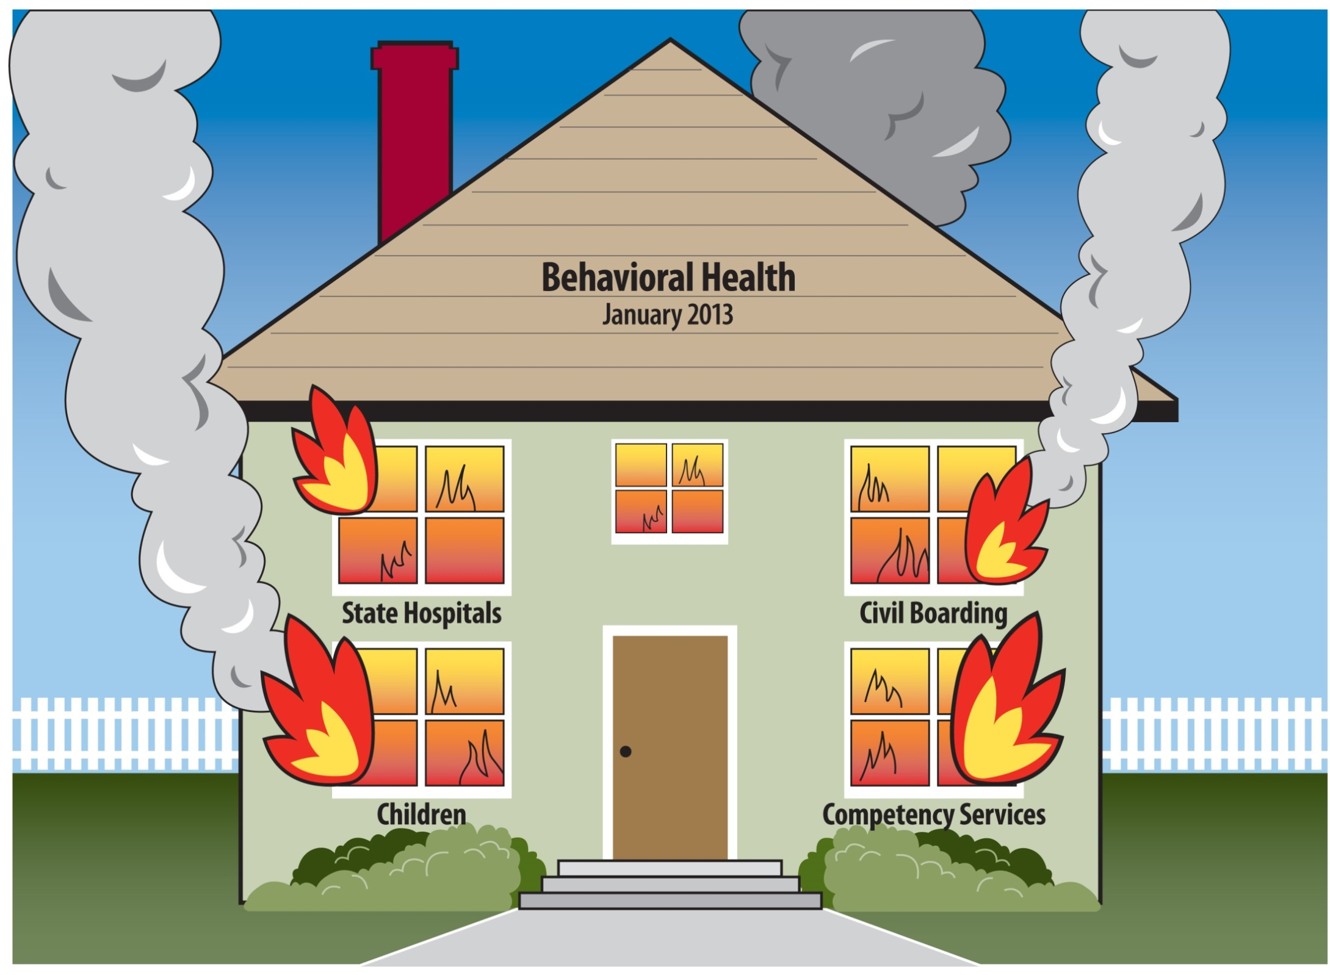

Slide 3
STATE PSYCHIATRIC HOSPITALS

Slide 4
“We need treatment, not detention.”
“Who the hell is in charge here?”
STATE PSYCHIATRIC HOSPITALS

Slide 5
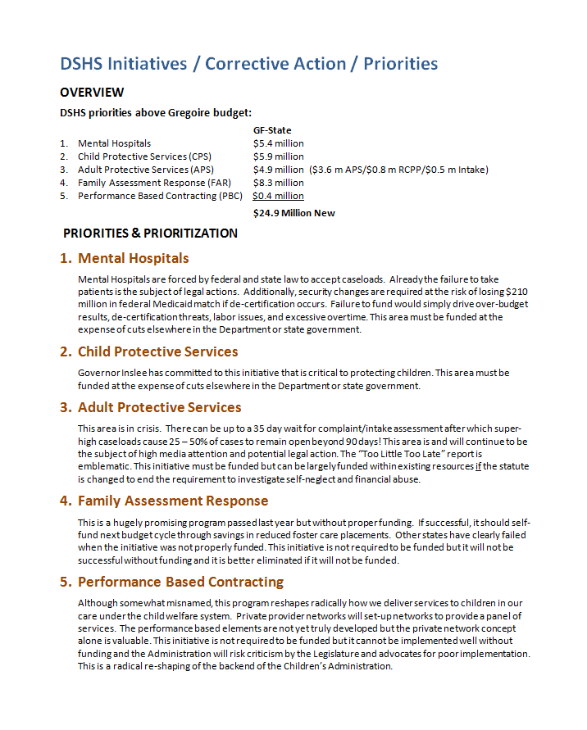
2013
Priorities
#1 Fiscal Priority:
State Psychiatric Hospitals
STATE PSYCHIATRIC HOSPITALS

Slide 6
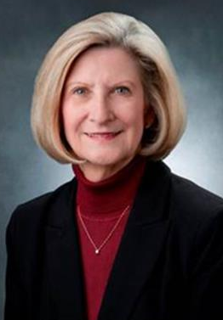
Three Pros, Three Heroes
Transforming Lives
Ron Adler, CEO
Western State Hospital
Lakewood, Washington
Dorothy Sawyer, CEO
Eastern State Hospital
Medical Lake, Washington
Rick Mehlman, CEO
Child Study and Treatment Center
Lakewood, Washington
STATE PSYCHIATRIC HOSPITALS
Notes:
From Dorothy Sawyer
1. As the hospital CEO, I am most proud of the leadership team that has been assembled during my tenure. This group of leaders has the talent, the skill set, the experience and the energy to carry out the DSHS Mission of Transforming Lives. They make me proud!
2. In relation to NAMI and mental health advocacy, I am very proud of the following:
Steve Einhaus, ESH Peer Specialist was awarded NAMI Volunteer for the year from the Spokane Chapter
ESH has formed a Patient Rights Committee which will include patient members
ESH facilitated a meeting between FSU patients and Washington State legislators where patients were able to voice their issues and concerns directly with elected representatives.
Lizanne Stolworthy M.Ed., LMHC was successfully recruited to fill the position of Patient Advocate

Slide 7
Western State Hospital FTE to Bed Ratio
Western State Hospital
FTE Expenditure to Bed Allotment
SOURCE: Washington State Department of Social and Health Services, Financial Services Administration, August 2015.
STATE PSYCHIATRIC HOSPITALS

Slide 8
Budgets Still Not Right
State Hospital GF-S Ending Year Balance Deficit (Before Proviso)
 | Western State Hospital | Eastern State Hospital | Child Study & Treatment Center | GRAND TOTAL
FY 2012 | —$3,198,000 | —$1,011,000 | $655,000 | —$3,554,000
FY 2013 | $973,000 | —$1,765,000 | $881,000 | $89,000
FY 2014 | —$196,000 | —$1,731,000 | $228,000 | —$1,699,000
FY 2015 | —$8,203,000 | —$3,132,000 | $96,000 | —$11,239,000
NOTES:
1. Dollars are rounded to the thousands.
2. SFY 2012 through SFY 2014 cash and liquidations, SFY cash and accruals.
3. SFY 2013 Supplemental Security Enhancement funding removed.
4. SFY 2014 Supplemental Overtime funding removed.
5. SFY 2015 Supplemental Hospital Shortfall funding removed.
Data provided by DSHS Financial Services Administration, August 2015.
STATE PSYCHIATRIC HOSPITALS

Slide 9
Western State Hospital Civil Wait List
January 2013 – August 2015
2013
2014
2015
SOURCE: Washington State Department of Social and Health Services, Behavioral Health and Service Integration Administration, Division of Behavioral Health and Recovery, August 2015.
STATE PSYCHIATRIC HOSPITALS

Slide 10
Five
Goals for State Psychiatric Hospitals
Eliminate waitlists
Increase treatment hours
Reduce assaults
Reduce seclusion and restraint
Reduce overtime
STATE PSYCHIATRIC HOSPITALS

Slide 11
STATE PSYCHIATRIC HOSPITALS

Slide 12
CHILDREN’S INTENSIVE MENTAL HEALTH SERVICES

Slide 13
5970
SERVICES DENIED
CHILDREN’S INTENSIVE MENTAL HEALTH SERVICES

Slide 14
T.R. Settlement (December 2013) Services to be Provided through CANS Screening and WISe Model
Child and Adolescent Needs and Strengths Screening and Assessment (CANS)
Comprehensive and holistic assessment
Available for any child
Wraparound with Intensive Services (WISe)
Intensive care coordination
Intensive services provided in home and community setting
Mobile crisis intervention and stabilization
14
CHILDREN’S INTENSIVE MENTAL HEALTH SERVICES
Notes:
Total amount for TR in 2015-17 = $130 million (per DBHR)

Slide 15
WISe Rollout as of August 2015
19 of Washington’s 39 counties currently offer WISe, with a statewide monthly caseload capacity of 740 youth and their families/caregivers receiving services each month
Counties Offering WISe Services
AS OF AUGUST 2015
WHATCOM
SKAGIT
OKANOGAN
FERRY
STEVENS
PEND OREILLE
19
CLALLAM
SNOHOMISH
JEFFERSON
CHELAN
DOUGLAS
KITSAP
KING
LINCOLN
SPOKANE
GRAYS HARBOR
MASON
GRANT
PIERCE
KITTITAS
ADAMS
WHITMAN
THURSTON
PACIFIC
LEWIS
FRANKLIN
GARFIELD
YAKIMA
COLUMBIA
WAHKIAKUM
COWLITZ
SKAMANIA
BENTON
WALLA WALLA
ASOTIN
CLARK
KLICKITAT
CHILDREN’S INTENSIVE MENTAL HEALTH SERVICES

Slide 16
WISe Clients and Funding
July 2014 – June 2018 (Monthly Data)
June 2018
PROJECTED
Million/Month
≈ $85 million
ANNUALLY
Clients
Monthly Funding
June 2015
Million/Month
2015-17
BIENNIUM END
FULL
ROLL-OUT
2014
2015
2016
2017
2018
SOURCE: Washington State Department of Social and Health Services, Behavioral Health and Service Integration Administration, Division of Behavioral Health and Recovery, August 2015.
CHILDREN’S INTENSIVE MENTAL HEALTH SERVICES

Slide 17
CHILDREN’S INTENSIVE MENTAL HEALTH SERVICES

Slide 18
PSYCHIATRIC BOARDING

Slide 19
Washington State’s Psychiatric Bed Availability
Psychiatric Beds per 100,000 persons • National Mental Health Services Survey, 2010
46th
in the Nation
WASHINGTON
SOURCE: Washington State Institute for Public Policy, “Inpatient Psychiatric Capacity and Utilization in Washington State,” January 2015.
Data used for ranking includes non-hospital psychiatric facilities, such as Evaluation and Treatment centers, and is considered a more reliable estimate of bed capacity than the widely circulated “report card” figure from the Academy of Emergency Physicians.
PSYCHIATRIC BOARDING
Notes:
Data from the 2010 National Mental Health Services Survey (N-MHSS)
The N-MHSS is a survey of all known mental health treatment facilities in the nation conducted by the federal Substance Abuse and Mental Health Services Administration (SAMHSA)
When all short-term mental health facilities were considered including E&Ts, Washington’s ranked 46th nationwide, with 619 beds per 100,000 residents.
Note: In the 2011 American Hospital Association survey WA ranked 49th, but that survey did not include E&Ts in the calculation.
IMAGE pulled from WSIPP report “Inpatient Psychiatric Capacity and Utilization in Washington State, January 2015 (data provided Mason Burley, author, for re-creation here).
Note from Mason Burley to Secretary Quigley: “You could tell Sec. Quigley that in 1995 I worked for Sen. John Moyer from Spokane as an intern. I gave a closed door presentation to then Sen. Quigley and other members/staff on welfare reform, and completely botched my talk! Hopefully this makes up for it, nearly twenty years later.”

Slide 20
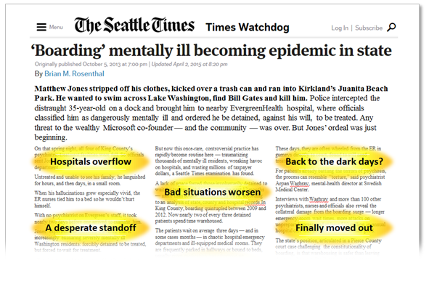
Psychiatric Boarding: SFY 2014 Daily SBC Census
Single Bed Certifications and Community Hospital Emergency Department Estimates
2013
2014
SOURCE: Washington State Department of Social and Health Services, Behavioral Health and Service Integration Administration, Division of Behavioral Health and Recovery, August 2015.
PSYCHIATRIC BOARDING
Notes:
Because there was no definitive data that measured psychiatric boarding, the issuance of SBCs was used as a proxy for describing the possible bed impact of boarding across the state.
Before August 2014 the state hospitals authorized SBCs and collected information on the patient and location of the request, but scrutiny of SBC requests was not very rigorous, and many SBCs were approved to address lack of available beds.
Before November 2013 DSHS issued an average of 300+ SBCs – By the peak in the 6 months just prior to August 2014 SBCs issued averaged around 535.

Slide 21
Q.
When is a 0-9 loss in the State Supreme Court a huge victory?
PSYCHIATRIC BOARDING

Slide 22
A.
When it triggers $30 million in spending to “buy” 145 more beds
. . . which could serve as many as 3,200 people per year
PSYCHIATRIC BOARDING

Slide 23
Positive
System Change
Increase in state hospital civil beds
Increase in evaluation and treatment (E&T) beds
Increase diversion
Increase crisis stabilization
PSYCHIATRIC BOARDING

Slide 24
New
Inpatient and Diversion Resources
2013 – 2017 Resources
San Juan
Whatcom
Okanogan
Ferry
Stevens
Pend Oreille
Skagit
Island
Clallam
Snohomish
Chelan
Jefferson
Kitsap
Douglas
Lincoln
Spokane
Grays Harbor
Mason
King
Kittitas
Grant
Pierce
Adams
Whitman
Thurston
Pacific
Lewis
Franklin
Garfield
Yakima
Columbia
Wahkiakum
Cowlitz
Benton
Walla Walla
Asotin
Skamania
Klickitat
New Freestanding E&T
New Inpatient Beds
New Crisis Triage
Mobile Crisis Team
PACT Team
Planned E&T
Clark
SOURCE: Washington State Department of Social and Health Services, Behavioral Health and Service Integration Administration, Division of Behavioral Health and Recovery, August 2015.
PSYCHIATRIC BOARDING
Notes:
New resources were funded via:
ESSB 5480 in 2013 – crisis and diversion services, including E&T, crisis triage, PACT, and mobile crisis teams
2014 Supplemental Budget – E&Ts and Program for Assertive Community Treatment teams (PACT)
SBC/Boarding response in 2015 – E&Ts and community inpatient totaling 145 new beds

Slide 25
Timely and Appropriate Mental Health Treatment
Blue Ribbon
Single Bed Certifications | 2014 |  | 2015
 | NOV | DEC | JAN | FEB | MAR | APR | MAY | JUN
Unduplicated people | 263 | 328 | 288 | 327 | 380 | 417 | 397 | 531
Average Daily Census | 91 | 81 | 73 | 95 | 100 | 103 | 99 | 154
Median Length of Stay (days) | 2 | 4 | 2 | 2 | 2 | 2 | 2 | 2
SOURCE: Washington State Department of Social and Health Services, Behavioral Health and Service Integration Administration, Division of Behavioral Health and Recovery, August 2015.
PSYCHIATRIC BOARDING

Slide 26
FORENSIC COMPETENCY SERVICES

Slide 27
Forensic Evaluation and Competency
Restoration Wait Times
Average Number of Days • Includes Felony and Misdemeanor
125 days
125 days
Competency Evaluations
Competency Restorations
Eastern State Hospital
Western State Hospital
Average (Both Hospitals)
TARGET
2013
2014
2015
2013
2014
2015
SOURCE: Washington State Department of Social and Health Services, Behavioral Health and Service Integration Administration, Division of Behavioral Health and Recovery, August 2015.
FORENSIC COMPETENCY SERVICES

Slide 28
Q.
When is a federal judge your friend?
FORENSIC COMPETENCY SERVICES

Slide 29
A.
When she is 95% right that wait times are unconstitutionally long
. . . and the legislature budgets $36 million to initiate the needed changes
FORENSIC COMPETENCY SERVICES

Slide 30
Fix Required by January 2016
13 more evaluators
90 more hospital beds
$1.7 million more for diversion
To achieve a 7-day service standard
FORENSIC COMPETENCY SERVICES
Notes:
2ESSB 5177 diversion funded under the following assumptions:
Estimated 200 persons a year with misdemeanors or non-violent felonies will have charges dismissed and receive outpatient services
Cost for services to 200 persons - $1.7 million annually

Slide 31
Challenges...
A Long Journey Ahead
Too few psychiatrists in the state • Veterans Administration and private hospitals pay higher salaries to psychiatrists, psychologists, and social workers • Number of orders received • Length of time it takes to receive an order • Length of time it takes to receive discovery information • The availability of mental health records • Scheduling of evaluations for evaluators • Length of time it takes to receive mental health records • Space in the jail to conduct evaluations • Jail staff availability to supervise area • Availability of interpreters • Availability of defense attorneys who want to be present • Willingness of defendants to participate in the evaluations • Travel times between the hospitals and jails • Medical clearances • Jail transport to the hospitals • Space in the hospitals • Difficulty recruiting forensic psychologists • Difficulty recruiting forensic psychiatrists • Difficulty recruiting forensic RNs • Lack of support staff • Construction delays • Renovating old wards that have been unoccupied • Moving patients around to accommodate more competency restoration space • Scheduling out of custody evaluations • Permits to use other state facilities • RFP timelines • Notifications to labor • Bargaining with four labor groups • Major remodel for state hospital wards • Too much staff turnover at the hospitals • Skyrocketing referrals for competency evaluations from county prosecutors • Chronic underfunding of staff training • Staff retention • Competing demands on staff to run a safe hospital and meet compliance for L&I, CMS, the Joint Commission, and others • Staff and patient safety concerns in the forensic admission wards • Important data is often unavailable • Lack of communication between different parts of the system • Notifications to labor • Concurrent implementation of Electronic Health Records at state hospitals
NOTE: This is not an exclusive list.
FORENSIC COMPETENCY SERVICES

Slide 32
Yes!
Clear Win
Less untreated jail time
Quicker path to recovery
FORENSIC COMPETENCY SERVICES

Slide 33
Hidden Super-Win
Diversion
Diversion
Diversion
FORENSIC COMPETENCY SERVICES

Slide 34
FORENSIC COMPETENCY SERVICES

Slide 35
New Era in Mental Health
Psychiatric hospitals for treatment
Increased community-based alternatives
High needs children will be served
Civil boarding is ended
Forensic competency services will be provided timely
35

Slide 36
New Era in Mental Health
Total Dollars, All Funds
6% increase
NEW RESOURCES
New Funding Level
$2.3 billion
1% increase
$2.2 billion
BASELINE LEVEL
$1.9 billion
BASELINE LEVEL
$1.6 billion
BASELINE LEVEL
Some Components of 2015-17 Increase:
Competency Evaluations | 4.6 million
Non-Felony Diversion | 4.8 million
Competency Restoration Wards | 26.8 million
Psychiatric Boarding | 57.1 million
Children (T.R.) | 46.0 million
NEW RESOURCES $139.3 million
$0
SOURCE: Washington State Department of Social and Health Services, Behavioral Health and Service Integration Administration, Division of Behavioral Health and Recovery, August 2015.
36

Slide 37
Yes!
Results that Matter
≈ 3,000 persons
no longer “boarding” without appropriate care
≈ 5,900 children
will receive the enhanced care they need
≈ 260 more persons
will be served in the state hospitals
≈ 78 persons/month
will no longer be waiting in jails for competency services
Notes:
NOTES from DAVE DANIELS to KWQ (not meant as talking points):
This is based on 120 new beds (90 forensic/30 civil) with an average length of stay of 160 days, and an average occupancy rate of 95%.
120 beds X (365/160 LOS) X 0.95 = 260 that can be served each year
I [Dave Daniels] double checked with a different methodology:
120 beds represents an 8.3% increase in capacity.
Over the past 3 years the average number of unduplicated persons served each year was about 2,600
Taking the 8% bed increase and applying an improved occupancy rate of 5% (95% over 90% previously, which probably was actually lower) I come up with an increase of 226 persons served, which makes me fairly comfortable with the 260 number above.

Slide 38
The number of persons served in the community mental health system has increased under the ACA
Average Monthly Caseload, Age 18 and Over
Plus ≈ 11,000 people
2013
2014
SOURCE: Washington State Department of Social and Health Services, Behavioral Health and Service Integration Administration, Division of Behavioral Health and Recovery, August 2015.
Notes:
This chart counts the average monthly caseload of persons ages 18 and older served in the community mental health system – over 150,000 persons a year
Numbers of adults served in state hospital MH services have moderated downward over time (good thing).
Increase in outpatient clients is attributed in part to the entry of newly eligible Medicaid clients through the ACA.

Slide 39
Spending on Chemical Dependency Treatment is Up
2003-05 through 2015-17 Biennium
Million
Up 163%
Since 2003-05 Biennium
Million
SOURCE: Washington State Department of Social and Health Services, Behavioral Health and Service Integration Administration, Division of Behavioral Health and Recovery, August 2015.

Slide 40
