Slide 1
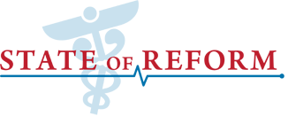
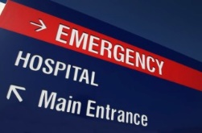
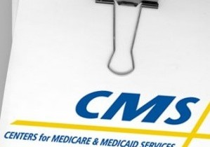
Cyber Security and Patient Privacy
2015 Inland Northwest State of Reform Health Policy Conference

Slide 2
Your Panelists
Randall J. Romes, CISSP, CRISC, MCP, PCI-QSA Principal, Information Security CliftonLarsonAllen LLP
randy.romes@CLAconnect.com
Theodore J. Kobus III
Partner Baker & Hostetler LLP
tkobus@bakerlaw.com
Seth Shapiro, CPCU, ARM, AIS, ARe
Executive Vice President & Risk Strategist
USI Kibble & Prentice
seth.shapiro@usi.biz

Slide 3
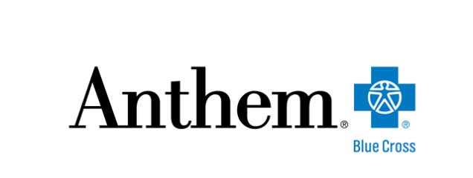
Healthcare in the Crosshairs
95.5 Million Records

Slide 4
“There are two types of companies: those who have been hacked, and those who don’t yet know they have been hacked.”
John Chambers, CEO of Cisco at The World Economic Forum

Slide 5
Companies are required to publicly disclose big health data breaches….
…and there were 280 such disclosures in 2014 and 177 to date in 2015

Slide 6
“It is an arms race between the criminal element and the people trying to protect health data.” – Robert Wah, MD, former President, AMA and first deputy national coordinator in the Office of the National Coordinator for Health Information Technology (ONC)

Slide 7
Going Prices for Black Market Medical Information
“…10 to 20 times the value of a US credit card number…” – Don Jackson, director of threat intelligence, PhishLabs
“The value of personal financial and health records is two or three times [the value of financial information alone].” – David Dimond, CTO, EMC Healthcare
“…black market…rate of $50 for each partial EHR…” – Medscape/FBI

Slide 8
open credit accounts
bill insurers or the government for fictitious medical care
obtain prescription medication
advance identity theft
ransomware
Monetization

Slide 9
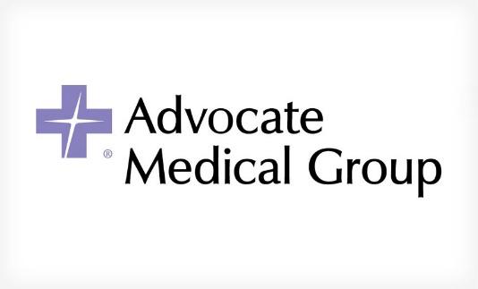
Legal Matters: The Good, The Bad and The Ugly
Advocate Health Ruling: The Impact August 19, 2015
Appellate court ruling upholding dismissal of two lawsuits against Advocate filed in the wake of a 2013 breach is a reminder of the challenges plaintiffs face when solid evidence of harm stemming from breaches is lacking.
Sony Settles Over Hack Attack September 3, 2015
Sony Pictures Entertainment has reached a tentative deal to settle a class-action lawsuit filed against it, stemming from its 2014 data breach, which resulted in the leak of personal information for up to 50,000 employees.
Is Neiman Marcus Case a Game-Changer? August 10, 2015
Neiman Marcus has asked a federal appeals court to reconsider its decision to allow a consumer class-action suit filed against the luxury retailer to move forward.

Slide 10
Common Sense Advice to Avoid Data Breach Liability
Inventory sensitive data and identify custodians and data storage locations
Be aware of applicable state and federal data security and breach notification laws
Regularly review and update corporate information security policies
Implement security measures with regard to computer systems (e.g., passwords, encryption, firewalls, anti-virus software)
Implement physical security measures (e.g., locked cabinets, shredders)
Implement best practices and train employees
Ensure compliance by vendors with whom sensitive information is shared
Conduct periodic data security assessments
Purchase (the right) Network Security & Privacy Liability insurance
“Best Practices for Avoiding Data Breach Liability,” Patrick J. O’Toole, Jr. and Corey M. Dennis, New England In-House, September 2013

Slide 11
Highly effective mitigations against adversaries using unsophisticated techniques
 |  |  |  |  |  | Helps Mitigate Intrusion Stage:
Mitigation strategy | Overall security effectiveness | User resistance | Upfront cost (staff, equipment, technical complexity) | Maintenance cost (mainly staff) | Helps detect intrusions | 1: Code execution | 2: Network propagation | 3: Data exfiltration
Application whitelisting | Whitelist permitted/trusted programs, to prevent execution of malicious or unapproved programs including DLL files, scripts and installers. | M | H | M | ● | ● | ● | ●
Patch applications | E.g., Java, PDF viewers, Flash, web browsers and Microsoft Office. Patch or mitigate systems with 'extreme risk' vulnerabilities within two days. Use the latest version of applications. | L | H | H | ● | ● | ● | ●
Patch operating system vulnerabilities | Patch or mitigate systems with 'extreme risk' vulnerabilities within two days. Use the latest suitable operating system. Avoid Windows XP. | L | M | M | ● | ● | ● | ●
Restrict administrative privileges | Restrict privileges to operating systems and applications based on user duties. Such users should use a separate unprivileged account for email and web browsing. | M | M | L | ● | ● | ● | ●

Slide 12
Anatomy of a Cyber Policy
Coverage | Description | You Need It If:
Cyber Network, Security, and Information | Protects your business from lawsuits related to data theft, spreading of computer viruses, and online service availability. Provides legal defense and funds for lawsuit settlements and judgments. | You store private customer information You send emails with attachments or make files available Your customers depend on your website to run their businesses Your customers could suffer financially if your system was unavailable
Cyber Errors, Omissions, and Wrongful Acts | Protects your business from lawsuits filed by people who have suffered financial losses because of mistakes you've made in the operation of your network, computer systems, or website. Provides funds for legal defense, settlements, and judgments. | Your error or design flaw could cause customers financial loss Your errors in published information could cause customers financial loss You store and safeguard customers' data Your operating mistake could cause financial loss to customers
Cyber Communications and Media Liability | Protects your business from lawsuits related to copyright or trademark infringement, and defamation, including slander and trade libel. Provides legal defense and funds for lawsuit settlements and judgments. | You publish information online referencing names and logos of businesses You use copyrighted photos, artwork, or other media you publish online You publish information that could unintentionally harm someone's reputation

Slide 13
Anatomy of a Cyber Policy
Coverage | Description | You Need It If:
Cyber Regulatory Expenses | Protects your business when a regulatory claim is made by a government entity as a result of customer data being stolen from your computer systems, network, or website. Provides funds for legal defense, lawsuit settlements, and judgments. | You could encounter a regulatory claim by a government entity
Cyber Extortion Threat | Protects your business from extortion threats made against it, by unidentified people, that involve your computer systems, network, or website. Reimburses for investigative expenses and payments made to an extortionist to prevent or mitigate the threat. | You are at risk of extortion threats
Cyber Terrorism | Protects your business when its computer systems, network or website are intentionally disrupted by others for political, religious, or ideological reasons - not for economic gain. Reimburses income lost due to the disruption and extra expenses necessary to restore your business operations. | You could be a target of terrorist groups

Slide 14
Anatomy of a Cyber Policy
Coverage | Description | You Need It If:
Cyber Crisis Management Expenses | Protects your business from damage caused by negative publicity due to a crisis, such as a hacker attack, security breach, data theft, or other online media claim. It pays for expenses necessary to protect and preserve your brand credibility during the crisis, including public relations firms, marketing communications, and advertising. It also covers the costs to help identify the person(s) responsible for the crisis, and any cash rewards paid for new information. | You need funds for marketing or advertising to help protect your reputation if security crisis You need funds to identify person(s) responsible
Cyber Security Breach and Identity Theft Expenses | Reimburses your business for expenses incurred when customer data is stolen from your computer systems, network or website. Pays for services to assess the data theft, identify and inform customers affected, and monitor customers' credit card and bank accounts for unusual activity that could result from the theft. | You need funds to contact customers if data is stolen
Cyber Computer Fraud | Protects your business when it suffers financial losses as a result of computer fraud. Reimburses the value of money, securities or property that are lost. | You need reimbursement for money, securities, or property stolen by unauthorized user

Slide 15
Anatomy of a Cyber Policy
Coverage | Description | You Need It If:
Cyber Software and Data Recovery Expenses | Reimburses your business for expenses incurred when software, data, or your website is damaged by a virus or hacker. Pays to restore, re-install, or re-configure software, and reproduce or restore data from backups. | You need reimbursement of costs to recover your damaged software, data, or website
Cyber Funds Transfer Fraud | Protects your business from the fraudulent transfer of money or securities. Reimburses the value of stolen funds or securities. | You need reimbursement for money or securities after your bank processes a fake or forged request
Cyber Business Interruption and Extra Expense | Reimburses your business for lost profits and extra expenses incurred from an interruption in your operations caused by an attack on your computer systems, network, or website by a hacker or computer virus. Expenses could include temporary computer systems, software, or consulting services required to restore your operations. | You need reimbursement for lost income and expenses if temporarily shut down

