Slide 1


EMPLOYER STRATEGIES FOR ACA
Presented by Terry Allard, CEBS
Senior Benefits Advisor

Slide 2
Key Parts of PPACA
Intended to increase number of Americans with health coverage
  Penalties for individuals without coverage
  Encouragement for employers to offer coverage
  Market reforms to improve access
  Expanded Medicaid eligibility

Slide 3
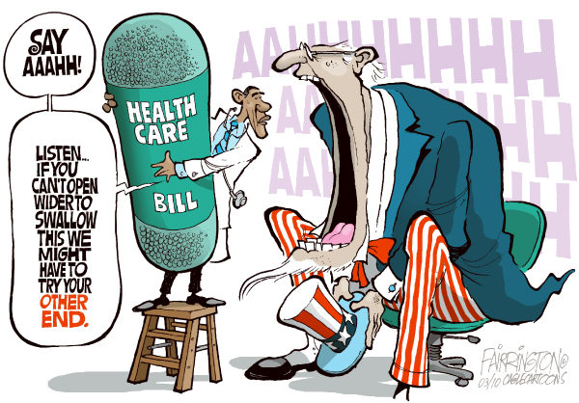
A tough pill to swallow?

Slide 4
Employer Encouragement
Tax credits may be available
Small employers (100 or fewer employees in most states) may enroll in an exchange for small businesses

Slide 5
Employer Encouragement
Employers are not required to offer medical coverage
penalty applies to employers with 50 or more employees who do not offer “minimum essential” coverage, or who offer coverage but the coverage does not provide “minimum value” or is not “affordable”

Slide 6
Employer Requirements
Coverage provided must meet “minimum value”
  60% considers employee’s cost share (deductible, co-pays, coinsurance)
  60% does not consider premium costs
Must offer to full time employees - 30 hours
Must provide after 90 days

Slide 7
Employer Strategies
Strategies include:
  Maintain current program
    Reduce employee hours
    Restructure employer contribution
    Eliminate spouse coverage
  Reduce benefits to minimum value
  Move to self funding

Slide 8
Employer Strategies
  SHOP exchange
  Private exchange
  Terminate plan and send employees to the marketplace/exchange

Slide 9
Exchanges
Intended to make it simpler for individuals and small employers to purchase health insurance
Exchange will not provide insurance

Slide 10
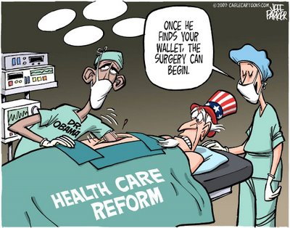

Slide 11
Exchanges
Exchange is somewhat like Orbitz or Expedia
  Will provide information on plan benefits and costs to make comparing options easier
  Will oversee the plans health insurers offer through the exchange
Notes:
The exchange can either accept all insurers/plans that meet the guidelines, or be an “active purchaser” of coverage and negotiate with insurers who wish to participate in an exchange

Slide 12
Exchanges
Plans must meet “cost sharing” requirements and provide “essential health benefits”
  Deductible may not exceed $2,000 for single or $4,000 for family coverage
  Out-of-pocket cannot exceed $6,250 for single or $12,500 for family coverage
Notes:
These amounts are indexed

Slide 13
Exchanges
  Essential health benefits are:
    Ambulatory (outpatient) care
    Emergency services
    Hospitalization
    Maternity and newborn care
    Mental health and substance abuse
    Prescription drugs
    Rehabilitative and habilitative services
    Laboratory services
    Preventive and wellness care, including chronic disease management
    Pediatric care
Notes:
Rehabilitative and habilitative services are things like speech, physical and occupational therapy. It’s rehab if the person could do it before, and lost the ability due to illness or an accident. Habiitative is if the person never could, for instance, speak. This means coverage for developmental delays would be covered.

Slide 14
Exchanges
Coverage to be available at several actuarial levels:
  Platinum – cover 90% of costs
  Gold – cover 80% of costs
  Silver – cover 70% of costs
  Bronze – cover 60% of costs

Slide 15
Exchanges
Small Business Health Options Program (SHOP) exchange to be provided for small employers
  Employer selects coverage level (e.g. a Silver plan)
  Each employee selects own plan within the selected coverage level (delayed to 2015)
  States may allow additional options
  Exchange provides consolidated bill to employer
  Employer must offer exchange coverage to all full-time employees
  No specific employer contribution required

Slide 16
Exchanges
Alaska will have a Federally Facilitated Exchange
A person may enroll in the exchange even if they have access to employer-provided coverage
Annual open enrollment each fall for a January 1 coverage date
Special enrollment required mid-year with life events
Notes:
Access to employer coverage may mean cannot get a premium tax credit

Slide 17
Exchanges
Individuals are eligible for a premium tax credit (subsidy) if certain conditions are met:
  Income is between 100% and 400% of Federal Poverty Line
    For 2013, FPL for Alaska:
      Single person is $14,350 - $57,400
      Family of four is $29,440 - $117,760
    Amount of subsidy reduces as income approaches 400% of FPL

Slide 18
Exchanges
Exchanges also responsible for:
  Providing website, navigators and other enrollment assistance to individuals
  Determining eligibility for premium tax credits (subsidy)

Slide 19
Employer Considerations
Discontinue coverage and rely on the exchanges
  Will that cause employees to demand additional, less tax-advantaged compensation?
    Defined contribution strategy
    More control over costs

Slide 20
Questions???
Contact:
We are happy to answer your questions.
Call The Wilson Agency at 907-277-1616
Or email terrya@thewilsonagency.com
This information is general and is provided for educational purposes only. It reflects UBA's understanding of the available guidance as of the date shown and is subject to change. It is not intended to provide legal advice. You should not act on this information without consulting legal counsel or other knowledgeable advisors.

