Slide 1
Hospitals Role in The Accountable Marketplace
October 9, 2013 State of Reform

Slide 2
Contents
The Accountable Marketplace
Defining Value
Providence Response

Slide 3
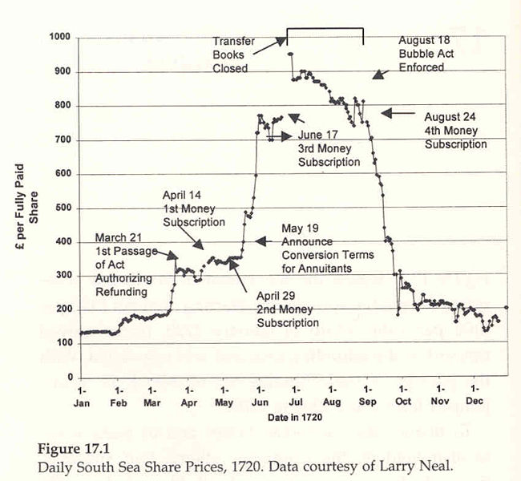
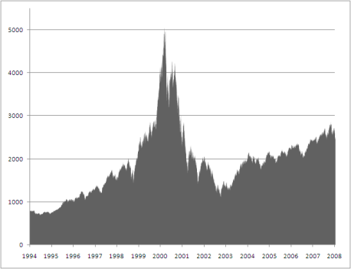
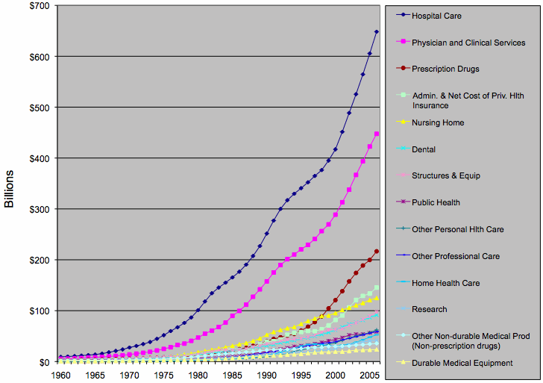
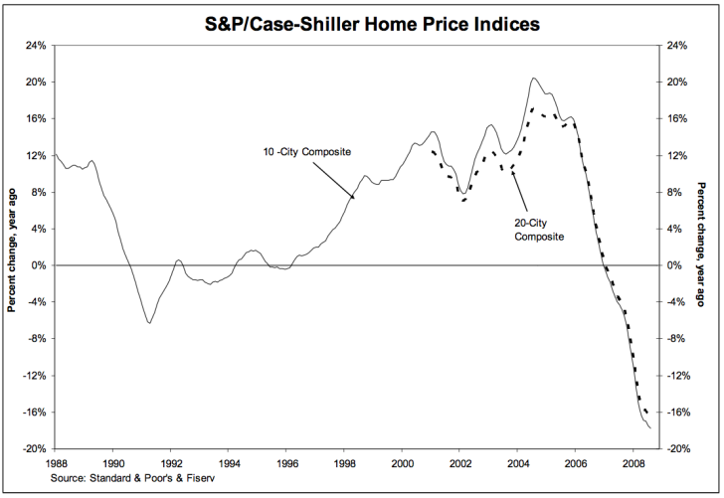
Can the healthcare bubble be popped?
South Seas Stock Bubble
Dot-Com Bubble
Health Care Bubble?
+25%
+60%
91-98
98-05

Slide 4
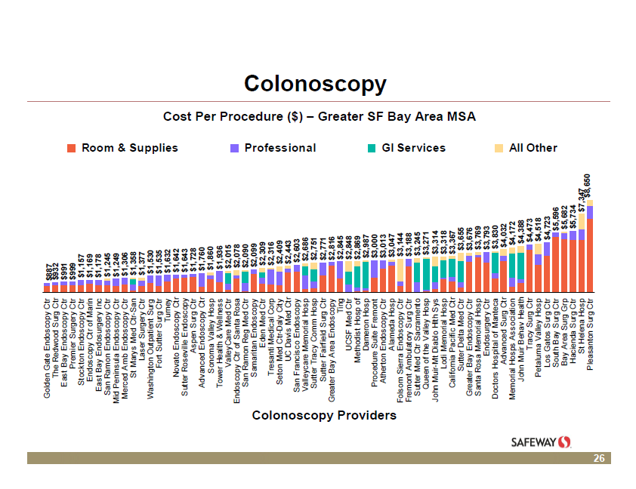
Incredible Price Variation
($887 to $8,650)

Slide 5
Wasteful Utilization

Slide 6
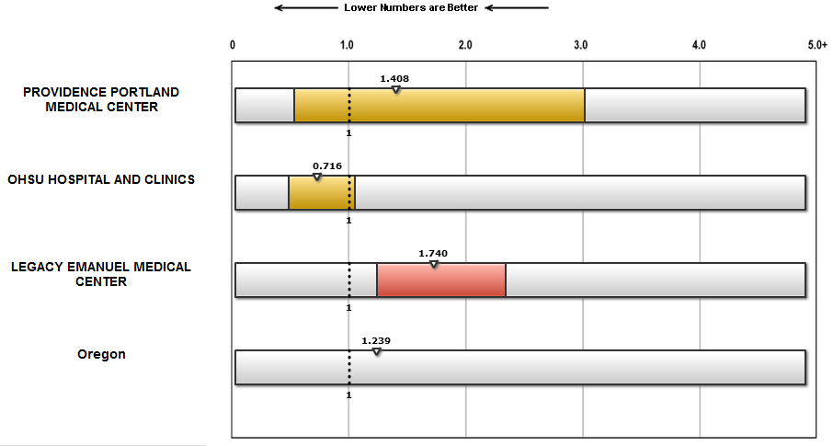
Variation in clinical outcomes/quality
Source: Catheter-Associated Urinary Tract Infections (CAUTI); hospitalcompare.hhs.gov

Slide 7
In a transparent marketplace…
Clinical Outcome + Experience
Price

Slide 8
The Result: An Accountable (or Value Based) Marketplace
Single Service (FFS)
Demand curve: Price vs location; connected data in the “system”
Levers to Create an Value Based Market
VB Benefit Design
Price/quality transparency
Tiered networks
Reference pricing
PCPs incented to lower total cost of care
ACO Networks
Condition Specific Bundle
Demand curve: Outcomes & Experience/Price; travel
ACO – Cross Condition
Demand curve: Outcomes & Experience/Price; Consumer Choice

Slide 9
Contents
The Accountable Marketplace
Defining Value
Providence Response

Slide 10
Fee-for-service Market
People assemble a “care package” on their own to solve their healthcare need.
A patient journey for a total joint replacement
over-utilization
Imaging
Re-admission
Physician Visit
Imaging
Surgery
Imaging
Lab
under-utilization
Patient Education
Care Management
Post-op Follow up

Slide 11
Accountable Market
We deliver “care packages” that create a connected experience & lower the price of care.
Coordinated total joint replacement journey
Physician Visit
Patient Education
Care Management
Imaging
Lab
Surgery
Physical Therapy
Pharmacy
Post-op Follow up
Spiritual/ Emotional Care

Slide 12
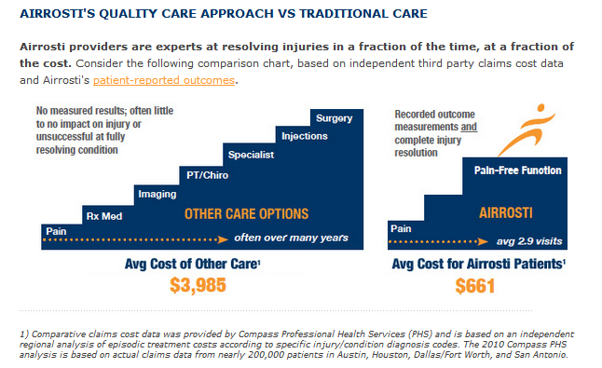
An Example…

Slide 13
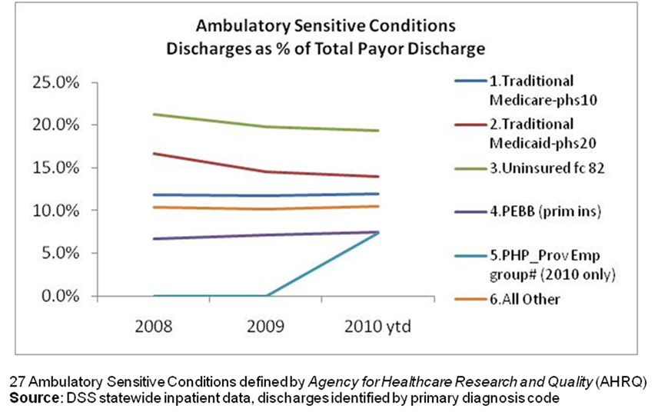
Less use of hospitals.

Slide 14
Contents
The Accountable Marketplace
Defining Value
Providence Response

Slide 15
Accountable Hospital
Hospital Physicians
Standardized credentialing/reference checking
Peer review
Engagement around patient experience
Culture of communication - preferred mode with medical group
Quality and Safety Practices
Transparency necessary (Much data is already publicly available)
Global trigger tools
Unusual occurrence reporting
Central line bundles
Safe surgery checklists
Care Management
Nurses
Service Line Management
Trusted Brand

Slide 16
Accountable Market Overview
Channel
Potential
Product
Roadmap
Provider
Alignment
Price
Position
AC
Infrastructure
Identify Payer or Channel
Medicare
Medicaid
Commercial
Providers
Employers
Direct to consumer
Level of Risk
Full Risk
Bundle/Sub-cap
Value-based FFS/P4P
Create Value
Medical Home/ACO
Care Package
Specialty Med Home
Retail Primary Care
Tele-health Primary Care
Capture Value
Accountable Pricing
Defend/grow market share with referring PCP
Lower cost in DRG
Proposed Care Delivery Network & Alignment Structures
Employment
ACO
Clinical Integration
Gain sharing
Medical staff
Estimated Cost & Margin
Capacity Optimization
Non-Provider Driven Direct Variable Costs
Overhead Costs
Digital Delivery (disruptive cost position)
Support Systems
Leadership Roles & Skills
New Performance Metrics
Population Health Analytics (payer neutral claims)
Claims processing
Bundle payment administration

