Slide 1

Leveraging
Resources with Outside Organizations
FOR HEALTH REFORM

Slide 2
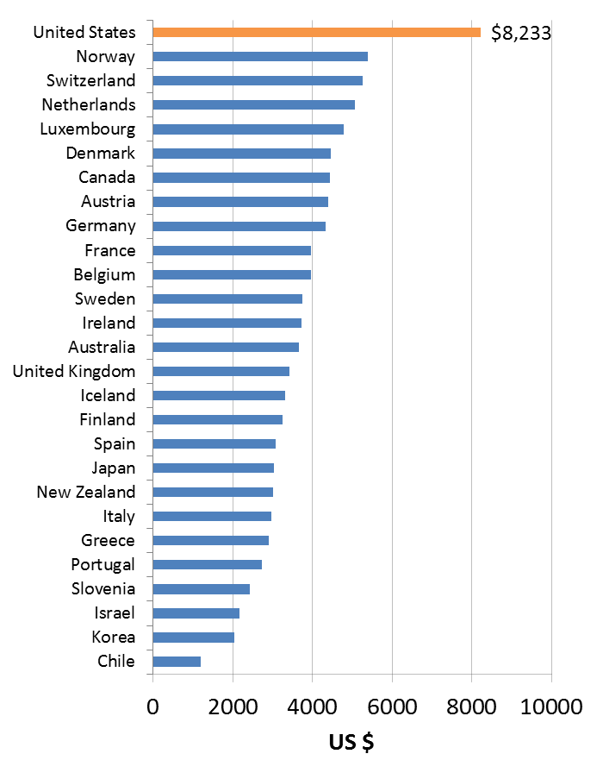
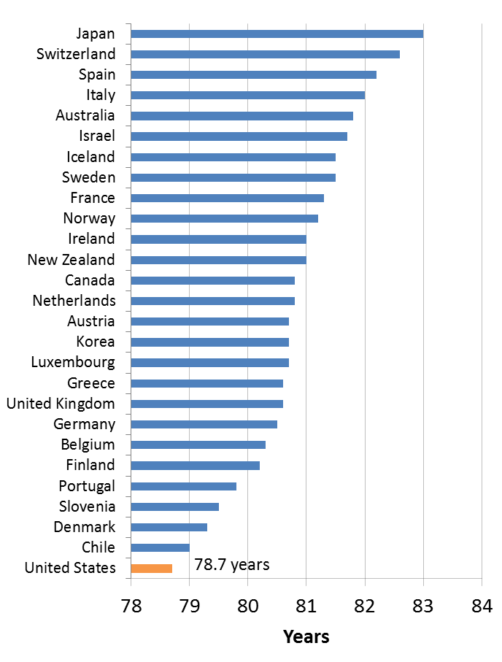
Life Expectancy and Health Spending
Per Capita Expenditure on Health
Life Expectancy at Birth
2010 or nearest year. Data Source: OECD Health Data 2012. Prepared by: Public Health-Seattle & King County; Assessment, Policy Development & Evaluation Unit; 7/2012.

Slide 3
Health Outcomes
Mortality (length of life)
Morbidity (quality of life)
Tobacco use
Health behaviors
(30%)
Diet & exercise
Alcohol use
Unsafe sex
Clinical care
(20%)
Access to care
Quality of care
Health Factors
Education
Employment
Social & economic factors
(40%)
Income
Family & social support
Community safety
Programs and Policies
Physical environment
(10%)
Environmental quality
Built environment
County Health Rankings model © 2010 UWPHI

Slide 4
LEVERAGING RESOURCES
  Federal Reserve’s Interest & Activities - Health Care
  SF Fed District’s Activities – Health Care
  Typical Outside Partners
  CRA and the ACA
  Examples of Collaboration

Slide 5
Federal Reserve Bank of SF
  Conducting the nation's monetary policy by influencing the monetary and credit conditions in the economy in pursuit of maximum employment, stable prices, and moderate long-term interest rates
  Providing financial services to depository institutions, the U.S. government, and foreign official institutions, including playing a major role in operating the nation's payments system
  Maintaining the stability of the financial system and containing systemic risk that may arise in financial markets
  Supervising and regulating banking institutions to ensure the safety and soundness of the nation's banking and financial system and to protect the credit rights of consumers

Slide 6
FRBSF Activities – Health Care
  Research & publications
  Conferences, workshops
  Initiatives with health care sector

Slide 7
Outside ORGANIZATIONS
  CHNA results
  Focus on preventive
  Geography – individuals and communities
    Organizations and agencies that assist low & moderate income individuals & communities
    Civic officials - Boroughs, towns, villages
    Financial institutions
    Foundations

Slide 8
Community Reinvestment Act
  Encourages financial institutions to extend credit to all of areas of their community, including low to-moderate income neighborhoods, consistent with safe and sound operation of the institution.
  Regulation: Assess bank’s loans, services and investments

Slide 9
Community Reinvestment Act
  Community Development
    Low & moderate income individuals & communities
    Small business, small farms
    Economic revitalization

Slide 10
ACA & CRA
Hospitals | Banks
Patient Protection & Affordable Care Act | Community Reinvestment Act
Better health outcomes & …. | Access to credit, CD
CHNAs – health needs | Performance context
->High needs | ->LMI, small farms and businesses, revitalization
Notes:
Moves Q&A from CD section to Performance Factors section of the Q&As. All activities with MWLIs qualify not just CD Activities.

Slide 11
ACA & CRA
Hospitals | Banks
Implementation strategies | CRA strategies, leadership, innovative
Limited $, need leveraging | Limited $, need leveraging
Challenges, barriers | Challenges, barriers
Impact | Impact

Slide 12
ACA and CRA
Hospitals | Banks
Access, alternative delivery systems | Multifamily affordable housing developments
Wellness campaigns | Workforce development
Life skills training | Financial education at LMI schools
Small business | Innovative lending – assistive technology
Notes:
Moves Q&A from CD section to Performance Factors section of the Q&As. All activities with MWLIs qualify not just CD Activities.

Slide 13
Next steps
Gather and overlay data: income, health
Research effective strategies, synergies
Gather organizations that share common goals and aspirations
Develop strategy that include a wide range of organizations (agencies, hospitals, nonprofits, foundations)
  Identify shared values and common interests
  Understand community needs and objectives
Notes:
Moves Q&A from CD section to Performance Factors section of the Q&As. All activities with MWLIs qualify not just CD Activities.

Slide 14


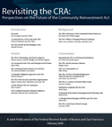
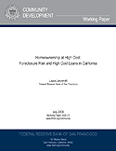
FRBSF Community Development
Research & Publications
  Magazines, Working Papers
National Programs
  Investments
  Native American
  Concentrated Poverty
Regional Initiatives
  Economic Development
  Asset Building
  Affordable Housing
  Healthy Communities

Slide 15
Leveraging
Resources with Outside Organizations
FOR HEALTH REFORM
Craig Nolte, Regional Manager
Community Development
Federal Reserve Bank of San Francisco
(206) 396-2192
craig.nolte@sf.frb.org

